Slide 1

Terro’s real estate agency

Slide 2
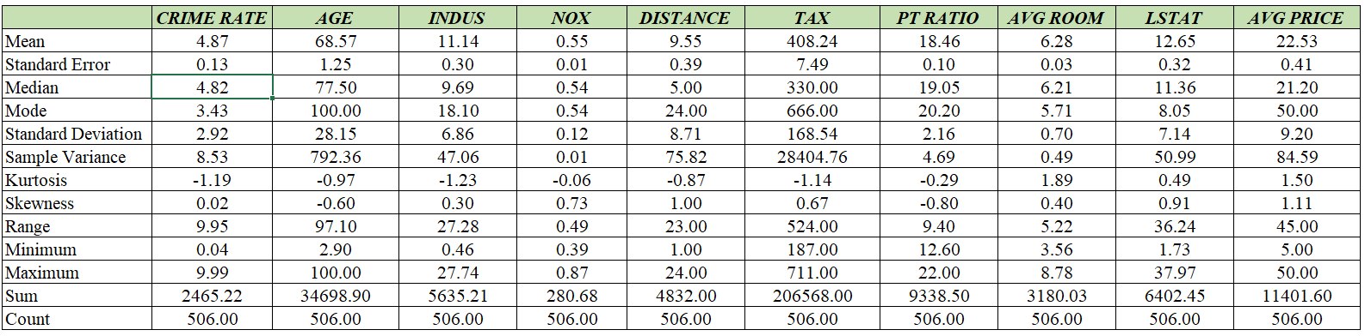
1) Generate the summary statistics for each variable in the table. (Use Data analysis tool pack). Write down your observation.

Slide 3
Observation:
Crime rate:
With a standard deviation of 2.92, the area's mean crime rate is 4.87. The minimum and maximum crime rates are 0.04 and 9.99, respectively. The data have a 0.02 skewness value, which indicates a minor positive skewness.
Age:
The population's mean age is 68.57, while its standard deviation is 28.15. The lowest and maximum ages are 2.9 and 100 respectively. The data has a skewness score of -0.6, which indicates a slight negative skew.
Industrialization:
With a standard deviation of 6.86, the mean number of non-retail business acres per town (INDUS) is 11.14. The range starts at 0.46 and goes up to 27.74. With a skewness score of 0.3, the data are negatively skewed.
Nitric oxide levels:
The mean NOX level (NOX) is 0.55 with a standard deviation of 0.12 in the data. The range starts at 0.39 and goes up to 0.87. With a skewness rating of 0.73, the data are positively skewed.

Slide 4
Observation:
Distance:
The mean weighted distances to five Boston employment centers (DISTANCE) are 9.55 miles, with an error of 8.71 miles. The range starts at 1 and goes up to 24. The data has a skewness value of 1, indicating positive skewness.
Tax:
Using a standard deviation of 168.54 and a mean full-value property tax rate of 408.24 per $10,000 (TAX), tax is calculated. The range is between 187 and 711 points. With a value of 0.67 for skewness, the data is positively skewed.
Pupil-teacher ratio:
The mean pupil-teacher ratio (PT RATIO) for each town is 18.46, while the standard deviation is 2.16. 12.6 is the minimum and 22 is the maximum. The data has a skewness value of -0.8, which indicates a negative skewness.
Average number of rooms:
There are 6.28 rooms on average per home (AVG ROOM), with a 0.7 standard deviation. 3.56 is the minimum and 8.78 is the maximum. The data has a skewness score of 0.4, which indicates a little positive skew.

Slide 5
Observation:
Lower status percentage:
The mean LSTAT (lower status percentage of the population) is 12.65, with a standard deviation of 7.14. The range starts at 1.73 and goes up to 37.97. With a skewness rating of 0.91, the data are positively skewed.
Average price:
The mean price of an owner-occupied home is 22.53, with a standard deviation of 9.20. 5 is the lowest and 50 is the maximum. The data has a positive skewness of 1.11, indicating that it is unbalanced.
Kurtosis:
All of the variables' kurtosis values are negative, indicating platykurtic distributions, which are flatter and have shorter tails than normal distributions.
In conclusion, we can see that the variables have different ranges and distributions. Some variables, such as crime rate and nitric oxide concentration, are positively skewed, while others, such as age and pupil-teacher ratio, are negatively skewed.

Slide 6
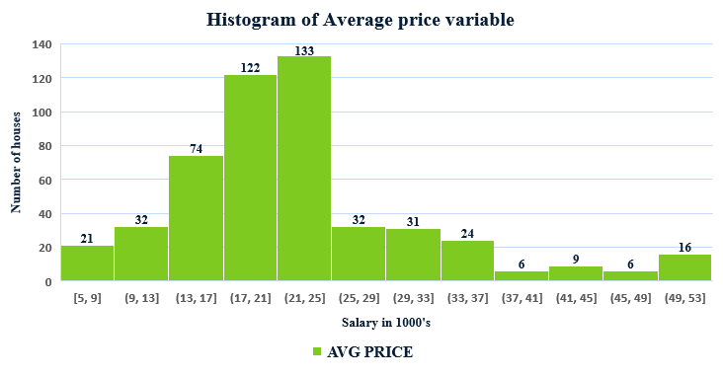
2) Plot a histogram of the Avg Price variable. What do you infer?

Slide 7
Observation:
The people with average salary of Rs.21,000 to Rs.25,000 are more in the area of Boston. The count of their houses is more i.e. 133 houses compared to other average salaried people.
The count of middle class income people is more than the luxury people.
It is not a posh area. The people with income Rs.49,000 to Rs.53,000 is less compared to the people with income Rs.21,000 to Rs.25,000.
The number of houses with salary ranges from Rs.37,000 to Rs.41,000 and Rs.45,000 to Rs.49,000 are with least count of houses.

Slide 8
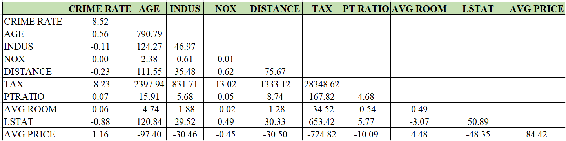
3) Compute the covariance matrix. Share your observations.

Slide 9
Observation:
Crime rate:
Because it is the same variable, the crime rate has a strong positive connection with itself. This statistic has an inverse relationship with average price, showing that locations with higher crime rates have lower average property prices.
Age:
Age has a positive correlation with average price, implying that older houses are more expensive.
INDUS:
Industrialization (INDUS) has a negative relationship with average price, implying that locations with a higher concentration of industrial assets have lower average house prices.
NOX:
The concentration of nitric oxides (NOX) shows a negative connection with average price, implying that places with higher NOX concentrations have lower average house prices.

Slide 10
Distance:
Distance from job hubs correlates negatively with average price, showing that places further distant from employment centers have lower average property prices.
Tax:
Tax has an inverse relationship with average price, showing that locations with higher tax rates have lower average housing values.
PT Ratio:
The pupil-teacher ratio (PTRATIO) shows a weak positive connection with average house price, implying that locations with lower PTRATIO have somewhat higher average house prices.
Avg Price:
The average number of rooms per home has a positive link with the average price, showing that larger houses tend to be more expensive.
LSTAT:
Lower-status population percentage (LSTAT) has a strong negative association with average price, implying that locations with a higher percentage of lower-status residents have lower average housing values.

Slide 11

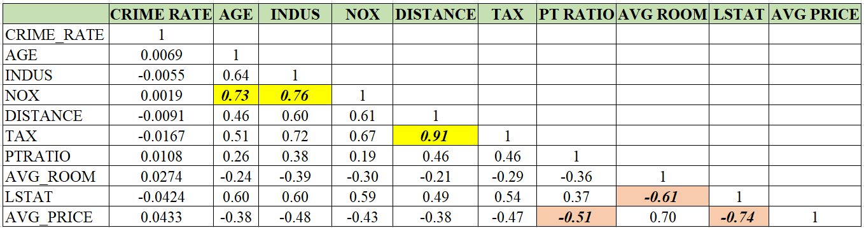
4) Create a correlation matrix of all the variables (Use Data analysis tool pack).

Slide 12
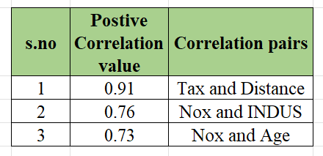
4a) Observation:
Tax and Distance:
It has a strong positive correlation. This means that as the distance from employment centers increases, the tax rate also tends to increase. This could be due to various reasons such as higher transportation costs for the government, increased demand for public services in areas that are farther from the city center, and so on.
NOX and INDUS:
It has a moderate positive cCrelation. This suggests that as the proportion of industrialization increases in a town, the NOX concentration tends to increase as well. This could be due to increased industrial activity and emissions from factories.
NOX and Age:
This indicates that as the proportion of older houses in a town increases, the NOX concentration tends to increase as well. This could be due to the fact that older houses may have outdated heating and cooling systems, leading to higher emissions, or that they may be located in areas with more traffic and industrial activity.

Slide 13
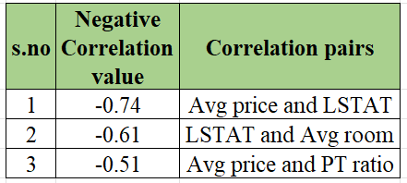
4b) Which are the top 3 negatively correlated pairs.
Observation:
Average price and LSTAT:
It indicates a strong negative correlation. LSTAT (percentage of lower status of the population) and this negative correlation implies that as the percentage of LSTAT increases, the average price of houses in the area decreases.
LSTAT and Average room:
It indicates moderate correlation. This implies that as LSTAT(percentage of lower status of the population) increases the average number of rooms in the houses decreases.
Average price and PT ratio:
PT ratio refers to the price-to-tax ratio, indicates a moderate negative correlation. this negative correlation implies that as the PT ratio increases, the average price of houses in the area decreases.

Slide 14
5) Build an initial regression model with AVG_PRICE as ‘y’ (Dependent variable) and LSTAT variable as Independent Variable. Generate the residual plot.

Slide 15
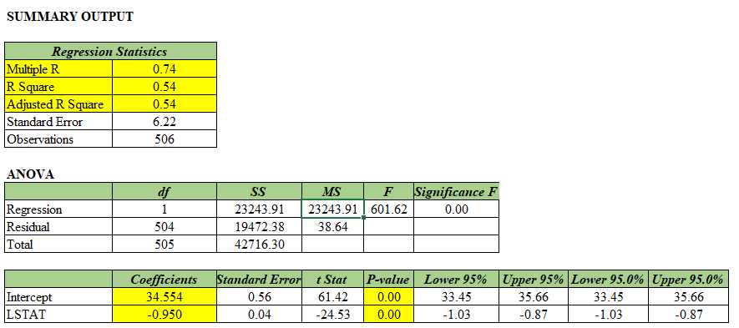
5a) What do you infer from the Regression Summary output in terms of variance explained,
coefficient value, Intercept, and the Residual plot?

Slide 16
5a Observation:
Variance:
The R-squared value (0.54) which is the variance indicates that 54% of the variation in the AVG_PRICE variable can be explained by the LSTAT variable in the model.
Coefficient Values:
The regression coefficients for the Intercept and LSTAT variables are 34.554 and -0.950, respectively. This means that for every unit increase in the LSTAT variable, the AVG_PRICE variable is expected to decrease by 0.95 units, holding all other variables constant.
Intercept:
The intercept of the regression model is 34.554, which represents the value of the AVG_PRICE variable when the LSTAT variable is zero.
Residual Plot:
It shows the differences between the observed values AVG_PRICE and the predicted values of the dependent variable based on the regression equation which is linear equation. The residual plot in this case shows that the residuals are randomly scattered around the zero line, indicating that the regression model is a good fit for the data.

Slide 17
5b) Is LSTAT variable significant for the analysis based on your model?
Observation:
Yes, the LSTAT variable is significant for the analysis based on the model as the p-value for the LSTAT variable is less than the standard alpha level of 0.05, which indicates that the coefficient for LSTAT is statistically significant.
The coefficient for LSTAT is negative, which indicates that an increase in the LSTAT variable is associated with a decrease in the AVG_PRICE variable, as expected.

Slide 18
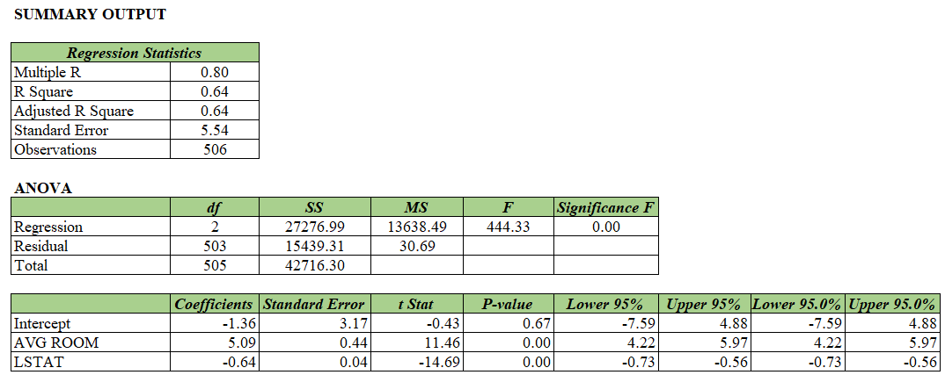
6) Build a new Regression model including LSTAT and AVG_ROOM together as Independent variables and AVG_PRICE as dependent variable.

Slide 19
6a) Write the Regression equation. If a new house in this locality has 7 rooms (on an average) and has a value of 20 for L-STAT, then what will be the value of AVG_PRICE? How does it compare to the company quoting a value of 30000 USD for this locality? Is the company Overcharging/ Undercharging?
Regression equation :
Avg Price = Intercept + (Coefficient of Avg_room * Average number of rooms) +
( Coefficient of LSTAT * Value of LSTAT)
Avg Price= 21.458076
Avg Price in Dollars = 21458 USD
Company quoting value = 30,000 USD
Observation:
According to the regression model the company is overcharging for the houses in this locality. it is important to note that the regression model only explains 54% of the variation in the AVG_PRICE variable and there may be other factors that the company is taking into account while quoting their prices.

Slide 20
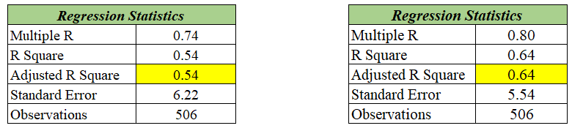
6b) Is the performance of this model better than the previous model you built in Question 5
Compare in terms of adjusted R-square and explain.
Previous model
Present model
Observation:
The Present model performed (0.64) better in explaining the regression model better than the previous model(0.54).
a higher adjusted R-squared value indicates that more variation in the dependent variable is explained by the independent variables.

Slide 21
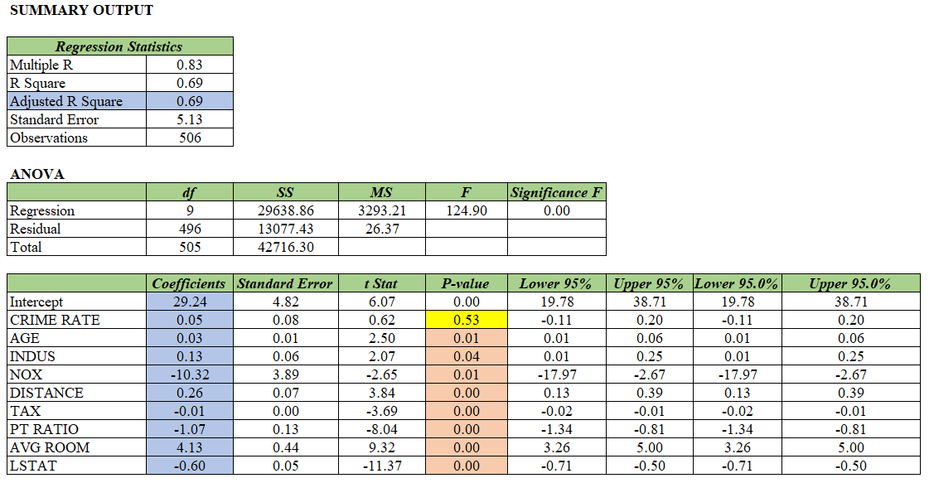

7) Build another Regression model with all variables where AVG_PRICE alone be the Dependent Variable and all the other variables are independent. Interpret the output in terms of adjusted Rsquare, coefficient and Intercept values. Explain the significance of each independent variable with respect to AVG_PRICE.

Slide 22
Observation:
Adjusted R square:
The adjusted R-squared value (0.69) which is the variance indicates that 69% of the variation in the AVG_PRICE variable can be explained by the other variable in the model like crime rate, Age, Industrialization, Nitrous oxide, Distance, Tax, PT ratio, Average room and LSTAT.
Intercept:
The intercept of the regression model is 29.29, which represents the value of the AVG_PRICE variable when all the other variables are zero.
Coefficient Values and Significance:
Crime rate:
The regression coefficients for the Intercept and crime rate variables are 29.29 and 0.5 respectively. The p–value is 0.53 i.e. the relationship is statistically insignificant. This means that for every unit increase in the crime rate variable, the AVG_PRICE variable is expected to increase by 0.5 units.
Age:
The regression coefficients for the Intercept and age variables are 29.29 and 0.03 respectively. The p–value is 0.01 i.e. the relationship is statistically significant. This means that for every unit increase in the age variable, the AVG_PRICE variable is expected to increase by 0.03 units.

Slide 23
INDUS:
The regression coefficients for the Intercept and Industrialization variables are 29.29 and 0.13 respectively. The p–value is 0.04 i.e. the relationship is statistically significant. This means that for every unit increase in industrialization variable, the AVG_PRICE variable is expected to increase by 0.13 units.
NOX:
The regression coefficients for the Intercept and Nitrous Oxide variables are 29.29 and -10.32 respectively. The p–value is 0.01 i.e. the relationship is statistically significant. This means that for every unit increase in NOX variable, the AVG_PRICE variable is expected to decrease by 10.32 units.
Distance:
The regression coefficients for the Intercept and Distance variables are 29.29 and 0.26 respectively. The p–value is 0 i.e. the relationship is statistically significant. This means that for every unit increase in distance variable, the AVG_PRICE variable is expected to increase by 0.26 units.
Tax:
The regression coefficients for the Intercept and Tax variables are 29.29 and -0.01 respectively. The p–value is 0 i.e. the relationship is statistically significant. This means that for every unit increase in tax variable, the AVG_PRICE variable is expected to decrease by 0.01 units.

Slide 24
PT Ratio:
The regression coefficients for the Intercept and PT Ratio variables are 29.29 and -1.07 respectively. The p–value is 0 i.e. the relationship is statistically significant. This means that for every unit increase in PT Ratio variable, the AVG_PRICE variable is expected to decrease by -1.07 units.
Avg room:
The regression coefficients for the Intercept and Avg room variables are 29.29 and 4.13 respectively. The p–value is 0 i.e. the relationship is statistically significant. This means that for every unit increase in Avg room variable, the AVG_PRICE variable is expected to increase by 4.13 units.
LSTAT:
The regression coefficients for the Intercept and LSTAT variables are 29.29 and -0.60 respectively. The p–value is 0 i.e. the relationship is statistically significant. This means that for every unit increase in LSTAT variable, the AVG_PRICE variable is expected to decrease by 0.60 units.

Slide 25
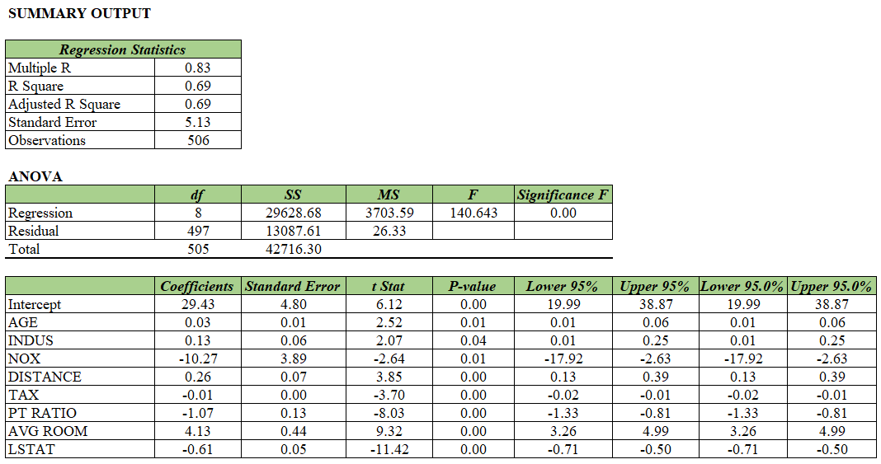
8) Pick out only the significant variables from the previous question. Make another instance of the
Regression model using only the significant variables you just picked and answer the questions
below:

Slide 26
8a) Interpret the output of this model.
Observation:
The output shows the results of a multiple linear regression analysis, which is used to model the relationship between a dependent variable and several independent variables. The model has eight independent variables: AGE, INDUS, NOX, DISTANCE, TAX, PT RATIO, AVG ROOM, and LSTAT
ANOVA:
The ANOVA table provides information on the overall significance of the model. The F-statistic is 140.643, with a p-value of 0.00, indicating that the model is statistically significant.
Intercept:
The intercept is estimated to be 29.43, indicating that when all independent variables are equal to zero, the expected value of the dependent variable is 29.43.
Coefficients:
Among the independent variables, AVG ROOM has the largest coefficient of 4.13, indicating that a one-unit increase in AVG ROOM is associated with a 4.13 unit increase in the dependent variable. LSTAT has the smallest coefficient of -0.61, indicating that a one-unit increase in LSTAT is associated with a -0.61 unit decrease in the dependent variable.

Slide 27
Observation:
R square:
The R-squared value of 0.69 indicates that about 69% of the variation in the dependent variable can be explained by the independent variables in the model. The adjusted R-squared value is the same as the R-squared value, suggesting that no additional independent variables are needed in the model.
Standard Error:
The standard error of the estimate (5.13) represents the average distance that the observed values deviate from the predicted values by the model.
P-value:
The p-value for all the independent variable are less than 0.05. So all the variables are statistically significant

Slide 28
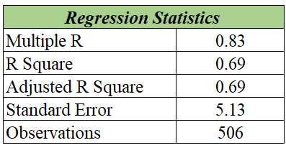
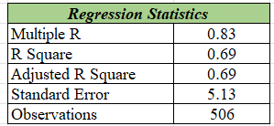
b) Compare the adjusted R-square value of this model with the model in the previous question,
which model performs better according to the value of adjusted R-square?
Previous model
Current model
Observation:
The adjusted R- square value of both the model are same.
Hence the Crime rate does not affect the regression model even with its presence and absence.

Slide 29
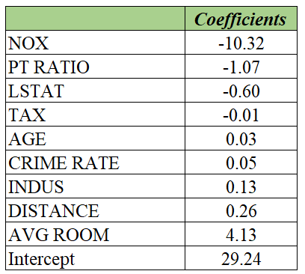
c) Sort the values of the Coefficients in ascending order. What will happen to the average price if the value of NOX is more in a locality in this town?
NOX:
The regression coefficients for the Intercept and Nitrous Oxide variables are 29.43 and -10.27 respectively. The p–value is 0.01 i.e. the relationship is statistically significant. This means that for every unit increase in NOX variable, the AVG_PRICE variable is expected to decrease by 10.32 units.
If the value of the Nitrous Oxide is more in a locality and when there increase in NOX variable, the AVG_PRICE variable is expected to increase by 10.32 units.

Slide 30
d) Write the regression equation from this model.
Avg Price = Intercept + (Coefficient of Age* x1) +(Coefficient of INDUS * x2) + (Coefficient of INDUS * x3) + (Coefficient of INDUS * x4) + (Coefficient of INDUS * x5) +( Coefficient of INDUS * x6) + (Coefficient of INDUS * x7) +( Coefficient of INDUS * x8)
= 29.43 + (0.03 *x1) + (0.03 *x2) + (0.03 *x3 ) + (0.03 *x4 ) + (0.03 *x5 ) + (0.03 *x6 ) + (0.03 *x7 ) + (0.03 *x8)

Slide 31
Thank you

